Slide 1

COMPUTER NETWORKS
(BCSC 0008)
SMTP
Copyright content, use only with the written permission of presenter mentioned

Slide 2
Text and Reference Books
Text Books:
Fourouzan B. A. (2004), “Data Communication and Networking”, 4th Edition, McGraw-Hill.
References:
Kurose, J. F. and Ross K. W. (2005), “Computer Networking: A Top-Down Approach Featuring the Internet”, 3rd Edition, Addison-Wesley.
A. S. Tanenbaum (2006), “Computer Networks”, 2nd Edition, Prentice Hall India.

Slide 3
20.1 ARCHITECTURE
To explain the architecture of email, we give four scenarios. We begin with the simplest situation and add complexity as we proceed. The fourth scenario is the most common in the exchange of email.
The topics discussed in this section include:
First Scenario
Second Scenario
Third Scenario
Fourth Scenario

Slide 4
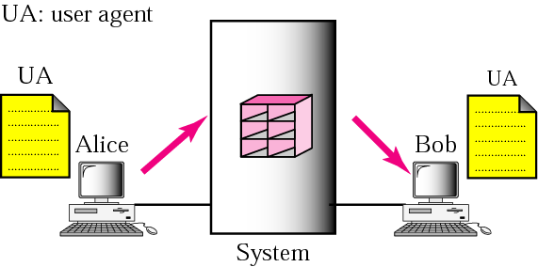
Figure 20.1 First scenario

Slide 5

Note:
When the sender and the receiver of an email are on the same system, we need only two user agents.

Slide 6
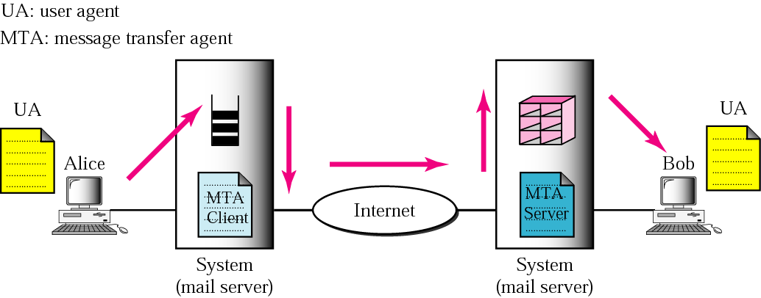
Figure 20.2 Second scenario

Slide 7
Note:
When the sender and the receiver of an email are on different systems, we need two UAs and a pair of MTAs (client and server).

Slide 8
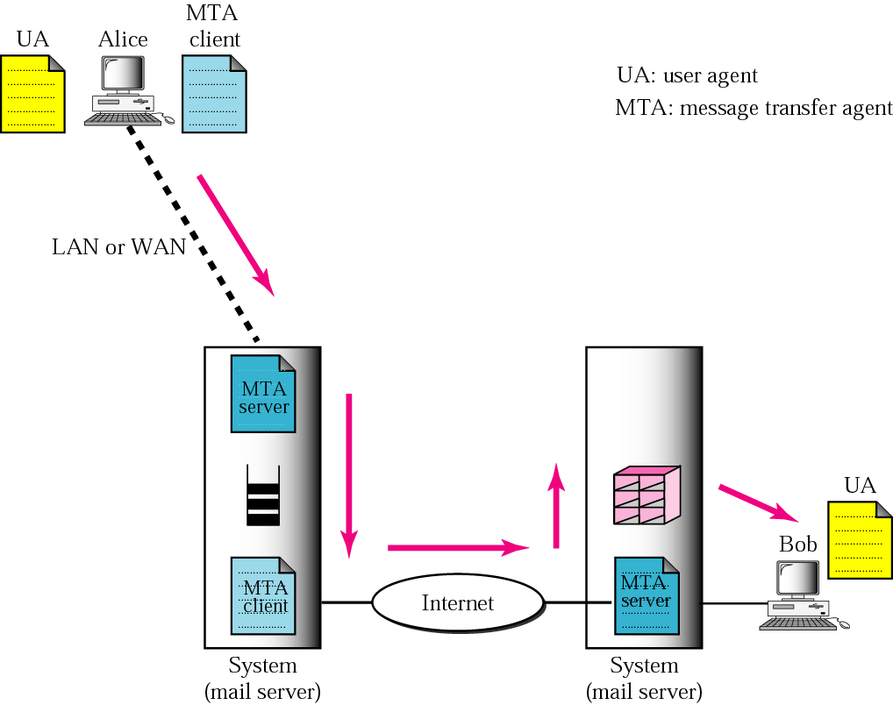
Figure 20.3 Third scenario

Slide 9
Note:
When the sender is connected to the mail server via a LAN or a WAN, we need two UAs and two pairs of MTAs (client and server).

Slide 10
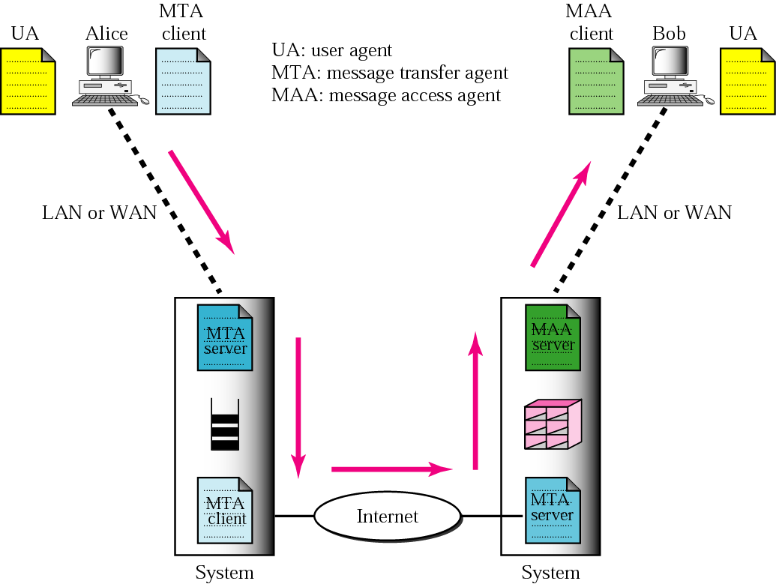
Figure 20.4 Fourth scenario

Slide 11
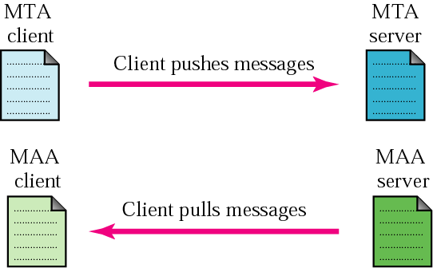
Figure 20.5 Push vs. pull

Slide 12
Note:
When both sender and receiver are connected to the mail server via a LAN or a WAN, we need two UAs, two pairs of MTAs (client and server), and a pair of MAAs (client and server). This is the most common situation today.

Slide 13
20.2 USER AGENT
The user agent (UA) provides service to the user to make the process of sending and receiving a message easier.
The topics discussed in this section include:
Services Provided by a User Agent
User Agent Types
Sending Mail
Receiving Mail
Addresses
Mailing List
MIME

Slide 14
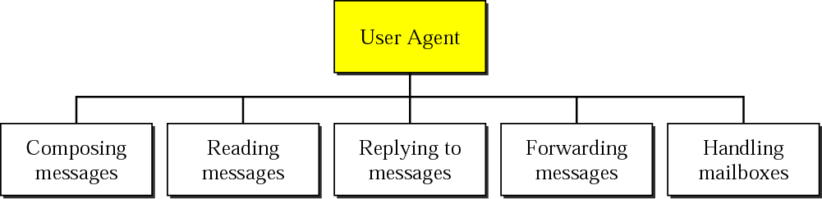
Figure 20.6 User agent

Slide 15
Note:
Some examples of command-driven user agents are mail, pine, and elm

Slide 16
Note:
Some examples of GUI-based user agents are Eudora, Outlook, and Netscape.

Slide 17
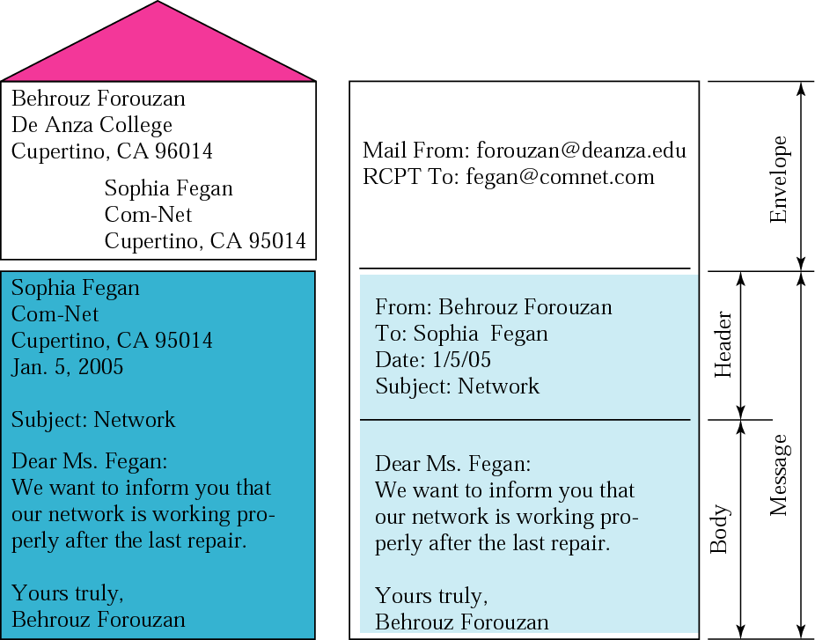
Figure 20.7 Format of an email

Slide 18
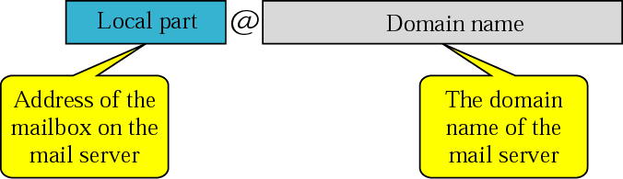
Figure 20.8 Email address

Slide 19
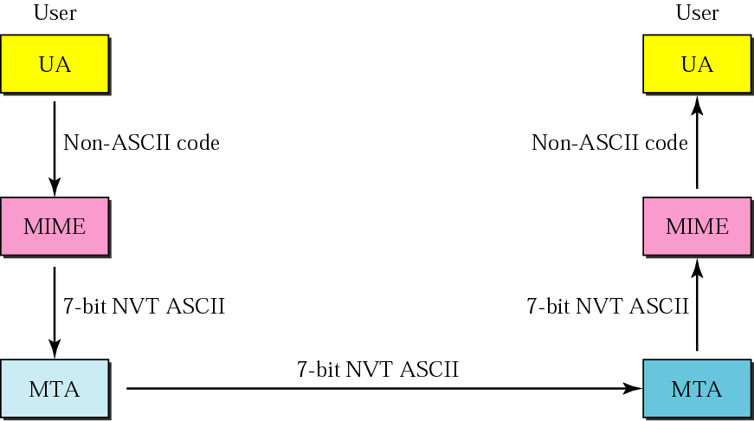
Figure 20.9 MIME

Slide 20
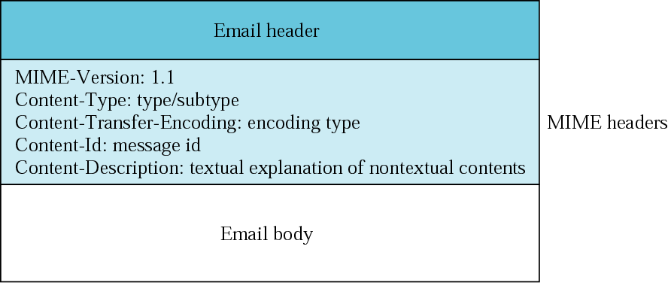
Figure 20.10 MIME header

Slide 21
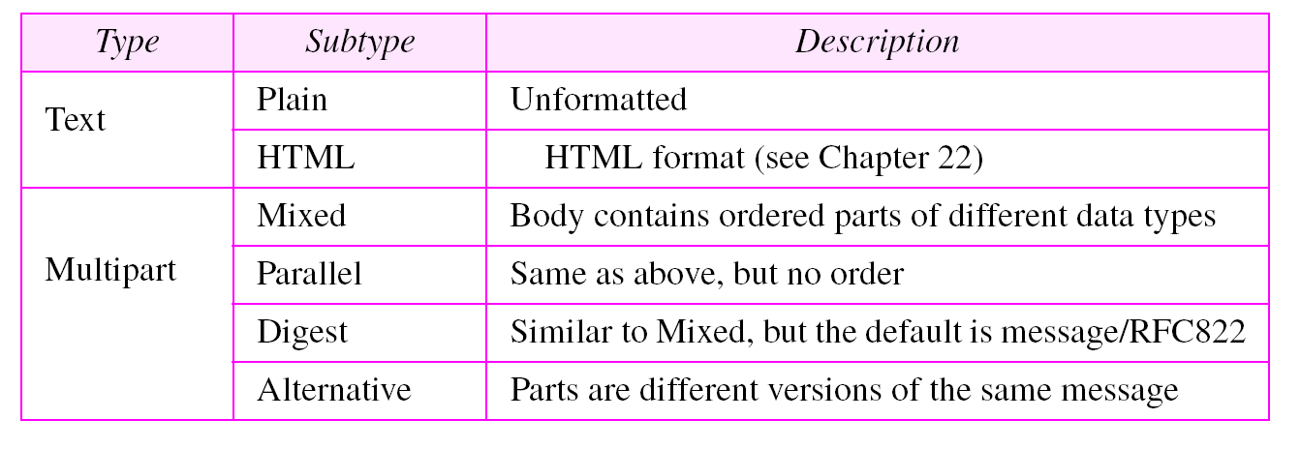
Table 20.1 Data types and subtypes in MIME

Slide 22
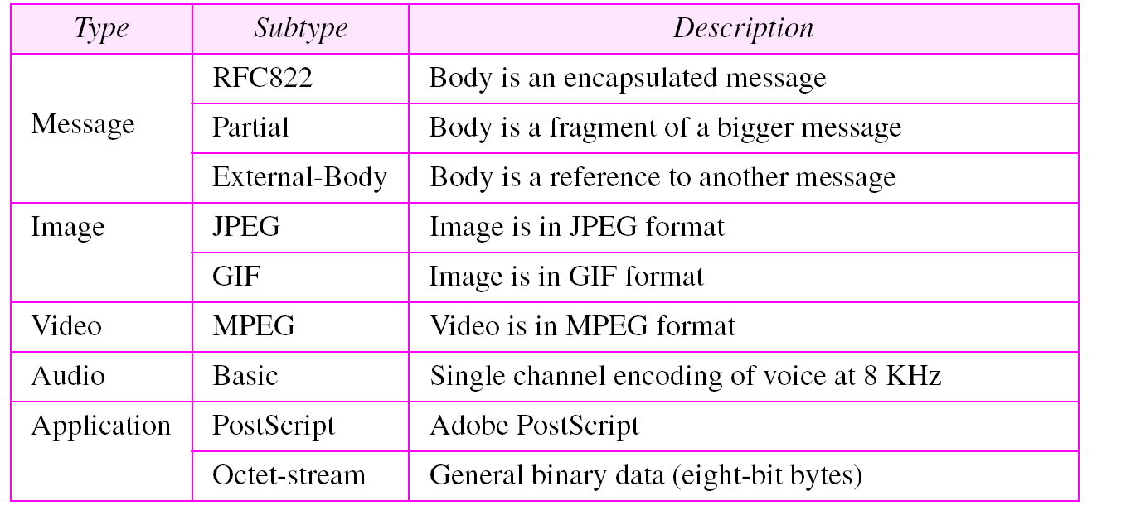
Table 20.1 Data types and subtypes in MIME (Continued)

Slide 23
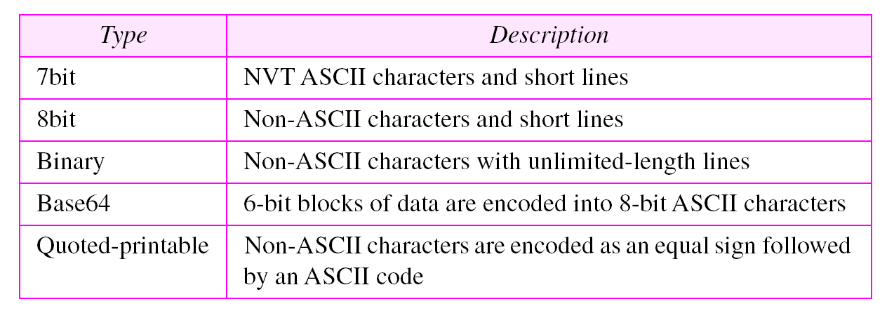
Table 20.2 Content-transfer-encoding

Slide 24
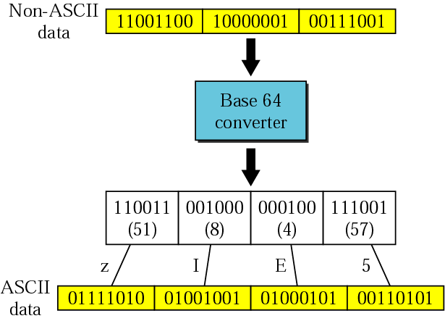
Figure 20.11 Base64

Slide 25
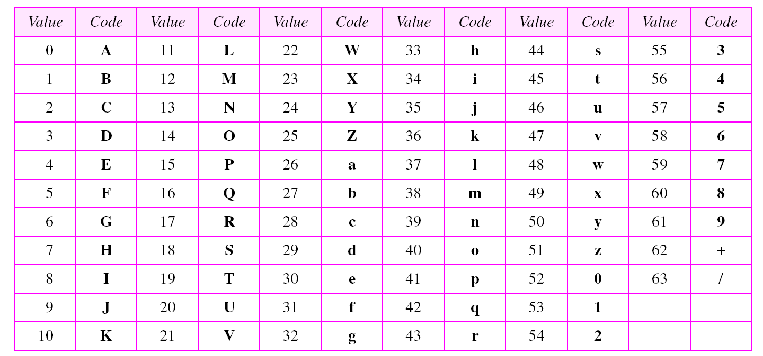
Table 20.3 Base64 encoding table

Slide 26
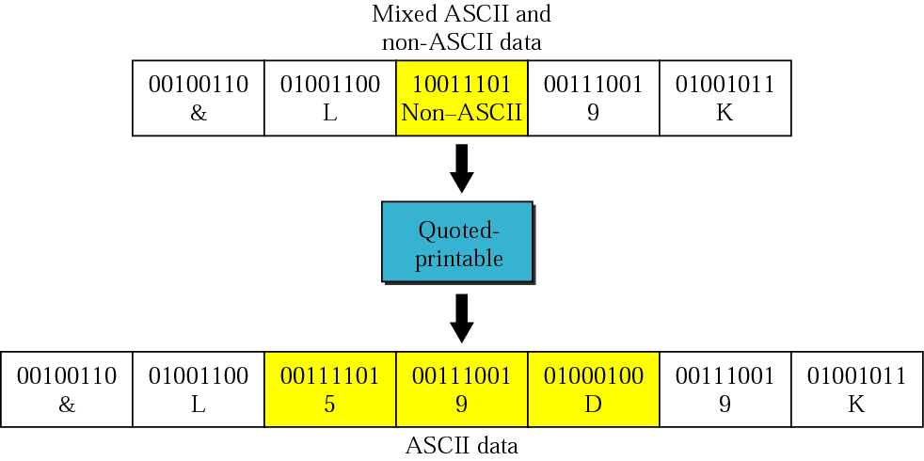
Figure 20.12 Quoted-printable

Slide 27
20.3 MESSAGE TRANSFER AGENT:
SMTP
The actual mail transfer requires message transfer agents (MTAs). The protocol that defines the MTA client and server in the Internet is called Simple Mail Transfer Protocol (SMTP).
The topics discussed in this section include:
Commands and Responses
Mail Transfer Phases

Slide 28
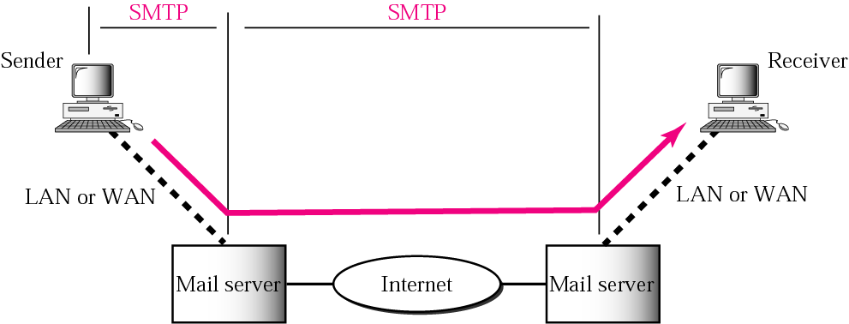
Figure 20.13 SMTP range

Slide 29
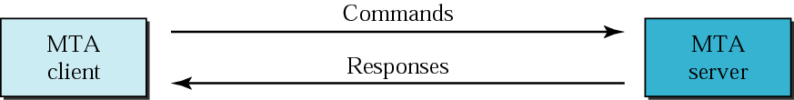
Figure 20.14 Commands and responses

Slide 30

Figure 20.15 Command format

Slide 31
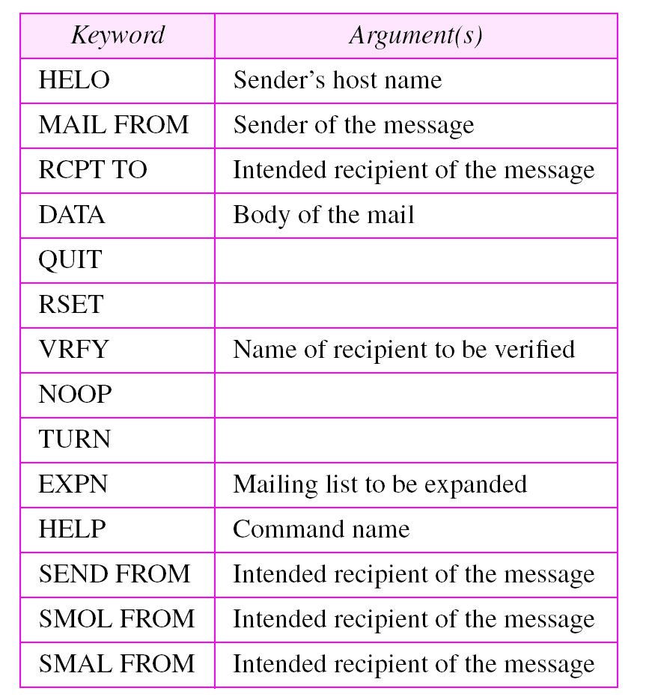
Table 20.4 Commands

Slide 32
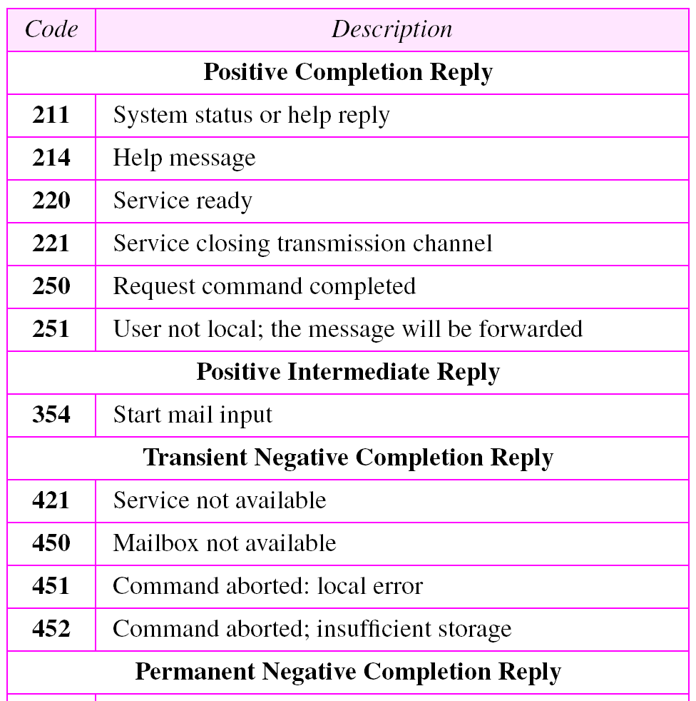
Table 20.5 Responses

Slide 33
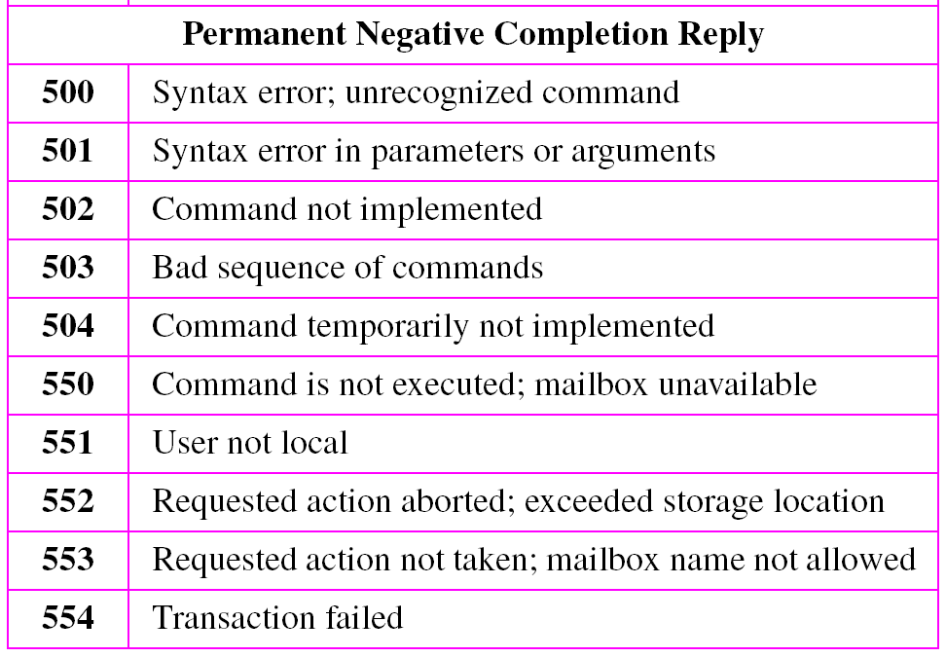
Table 20.5 Responses (Continued)

Slide 34
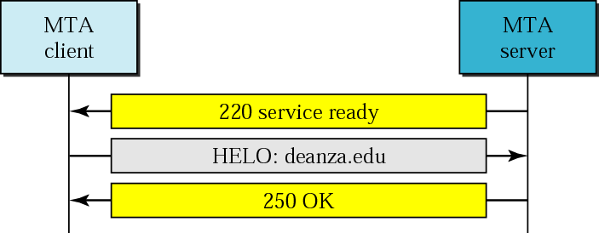
Figure 20.16 Connection establishment

Slide 35
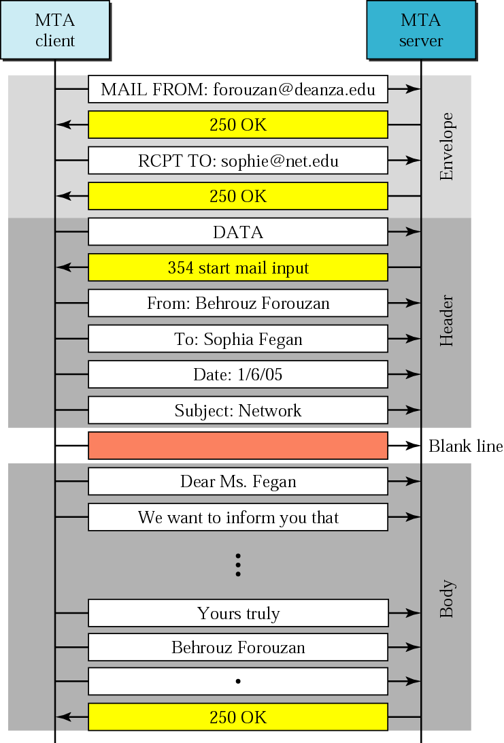
Figure 20.17 Message transfer

Slide 36
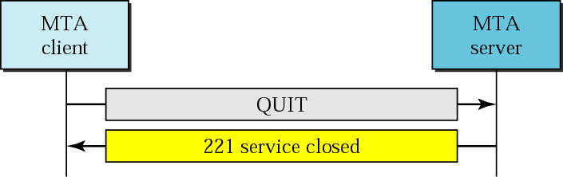
Figure 20.18 Connection termination

Slide 37
Example 1
Let us see how we can directly use SMTP to send an email and simulate the commands and responses we described in this section. We use TELNET to log into port 25 (the well-known port for SMTP). We then use the commands directly to send an email. In this example, forouzanb@adelphia.net is sending an email to himself. The first few lines show TELNET trying to connect to the adelphia mail server.
$ telnet mail.adelphia.net 25
Trying 68.168.78.100...
Connected to mail.adelphia.net (68.168.78.100).
After connection, we can type the SMTP commands and then receive the responses as shown below. We have shown the commands in black and the responses in color. Note that we have added for clarification some comment lines, designated by the “=” sign. These lines are not part of the email procedure.

Slide 38
Example 1 (Continued)
================== Connection Establishment ================
220 mta13.adelphia.net SMTP server ready Fri, 6 Aug 2004 . . .
HELO mail.adelphia.net
250 mta13.adelphia.net
===================== Envelope ===================
MAIL FROM: forouzanb@adelphia.net
250 Sender <forouzanb@adelphia.net> Ok
RCPT TO: forouzanb@adelphia.net
250 Recipient <forouzanb@adelphia.net> Ok
=================== Header and Body ==================
DATA
354 Ok Send data ending with <CRLF>.<CRLF>
From: Forouzan
TO: Forouzan
This is a test message
to show SMTP in action.
.

Slide 39
Example 1 (Continued)
============= Connection Termination===============
250 Message received: adelphia.net@mail.adelphia.net
QUIT
221 mta13.adelphia.net SMTP server closing connection
Connection closed by foreign host.

Slide 40
20.4 MESSAGE ACCESS AGENT:
POP AND IMAP
The third stage of mail delivery uses a message access agent; the client must pull messages from the server. Currently two message access protocols are available: Post Office Protocol, version 3 (POP3) and Internet Mail Access Protocol, version 4.
The topics discussed in this section include:
POP3
IMAP4

Slide 41
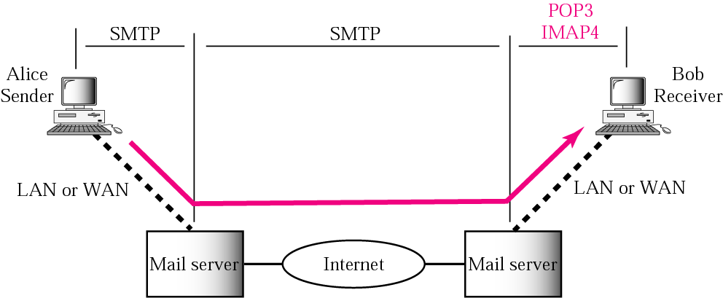
Figure 20.19 POP3 and IMAP4

Slide 42
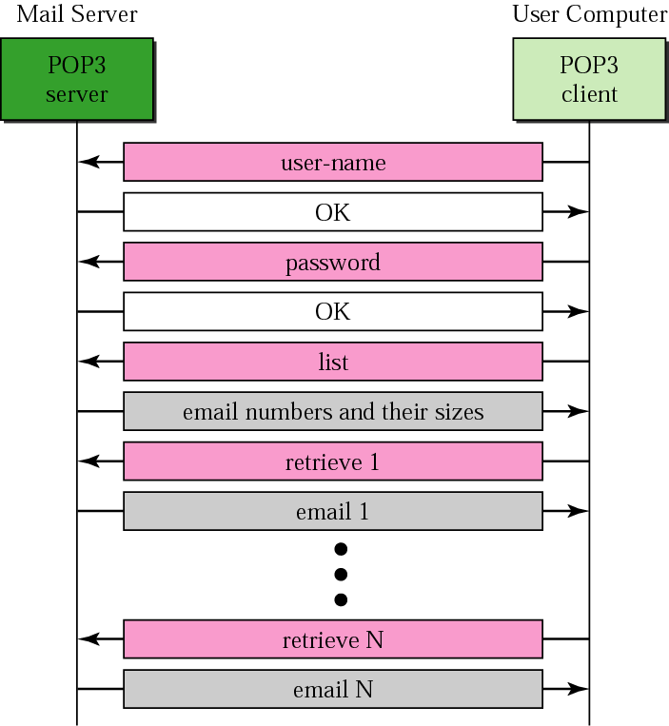
Figure 20.20 POP3

